Slide 1

AML-2203 Advanced Python AI and ML Tools
Lambton College
School of Computer Studies
[Prepared By: Vahid Hadavi, PhD]

Slide 2
Lecture1 1. Evaluate File and data set handling in Python (Recommended Module: scikit-learn, pandas)
Major Topics:
1.1 Discuss various format for data sets
1.2 Use Python to import various JSON and CSV files
1.3 Use Python to generate a random data set
1.4 Use Python modules to manipulate imported data and save them on disk

Slide 3
1.1 Discuss various format for data sets

Slide 4
File format
What is a file format?
A file format is a standard way in which information is encoded for storage in a file.
It specifies whether the file is a binary or ASCII file.
it shows how the information is organized.
For example, comma-separated values (CSV) file format stores tabular data in plain text.
Why we should understand different file formats?
Based on the application, different file formats are used.
Choosing the optimal file format for storing data can improve the performance of your models in data processing.

Slide 5
File format
Types
Comma-separated values (CSV)
JSON
ZIP
Plain Text (txt)
XLSX
XML
HTML
Images
PDF
DOCX
MP3
MP4

Slide 6
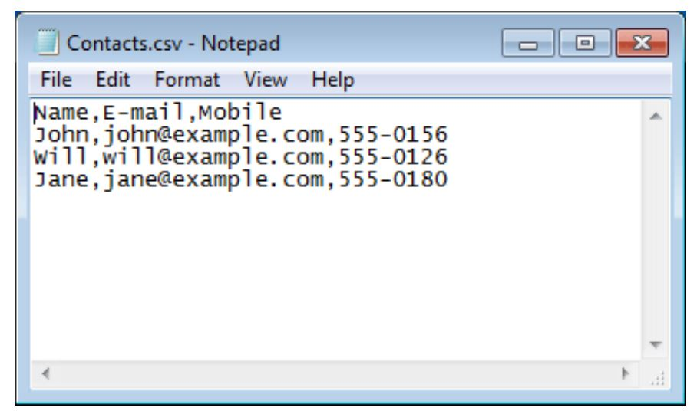
CSV
CSV file format stores tabular data in plain text.
Each line in CSV file represents an observation or commonly called a record.
Each record may contain one or more fields which are separated by a comma.

Slide 7
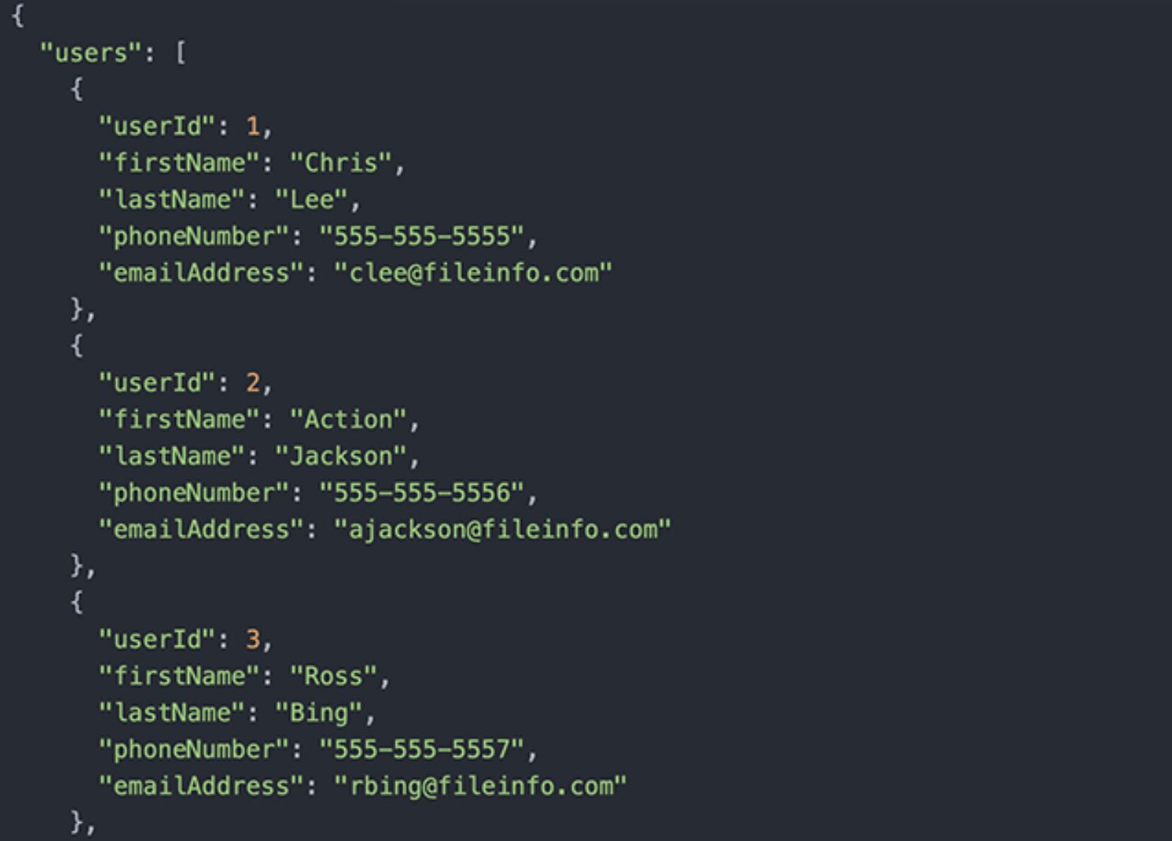
JSON
JavaScript Object Notation.
A text-based open standard designed for exchanging the data over web.
It is primarily used for transmitting data between a web application and a server.

Slide 8
1.2 Use Python to import various JSON and CSV files

Slide 9
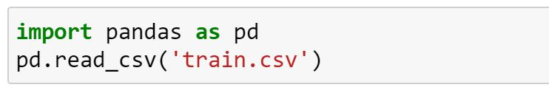
Loading CSV in python
For loading the data you can use the “pandas” library in python.
Some important arguments for read_csv method:
File path (required)
names (optional): lists of column names
sep (default “,”)
header (optional): row number to use as column names
index_col (optional): column to use as row numbers

Slide 10
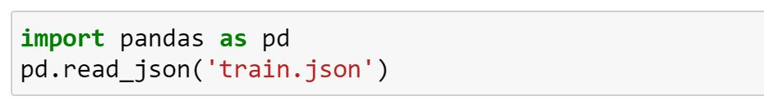
Loading JSON in python
For loading the data you can use the “pandas” library in python.
Some important arguments for read_json method:
File path (required)
typ (optional): {‘frame’, ‘series’} the type of object to recover

Slide 11
1.3 Use Python to generate a random data set

Slide 12
Creating random data
scikit-learn offers many methods for creating simulated data.
Three most used methods to create random data in scikit-learn:
make-regression
Designed to be used with linear regression
Make-classification
Creating a simulated dataset for classification
Make-blobs
Designed to work well with clustering techniques

Slide 13
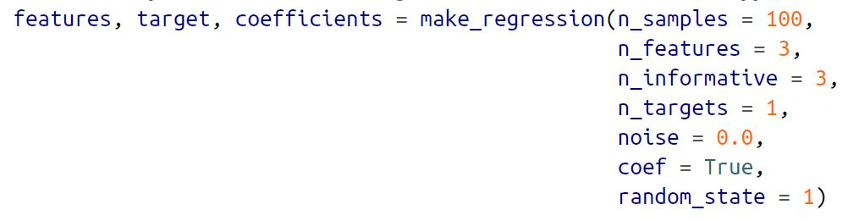
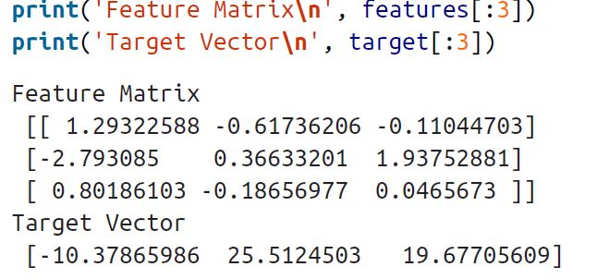
Make-regression example
Creating 100 samples with 3 features.
We can check the randomly created features and the corresponding targets.
from sklearn.datasets import make_regression

Slide 14
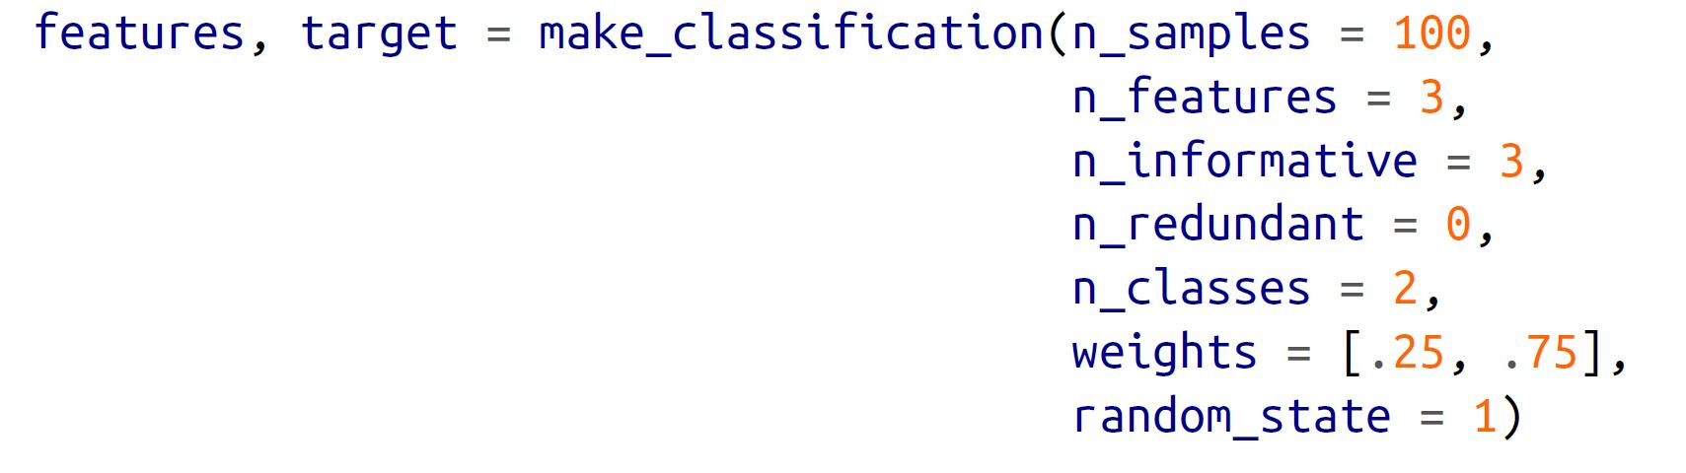
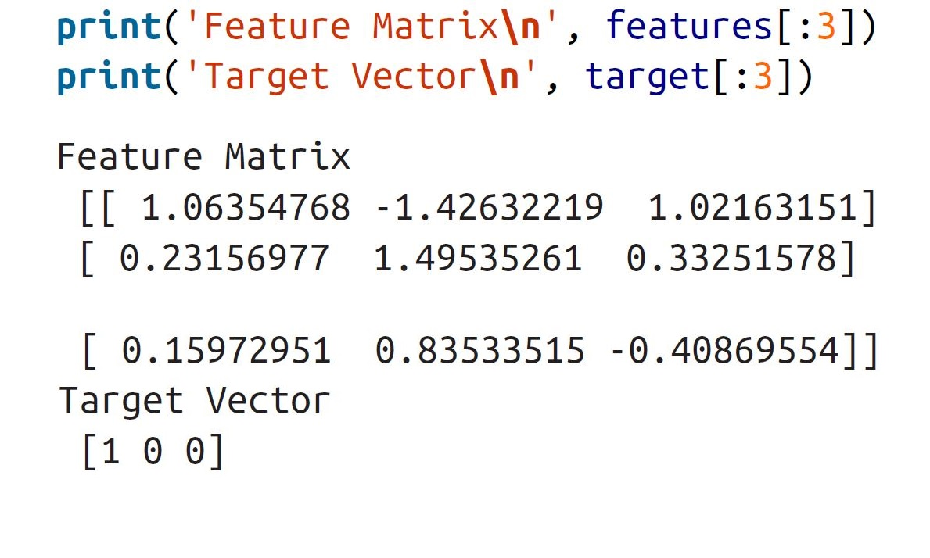
Make-classification example
Creating 100 samples with 3 features for two classes.
We can check the randomly created features and the corresponding targets.
Challenge question:
check data type for ‘features’ and ‘target’
Create a dataframe including the ‘features’ and ‘target’

Slide 15
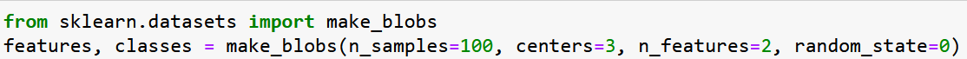
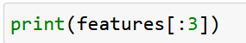
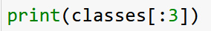
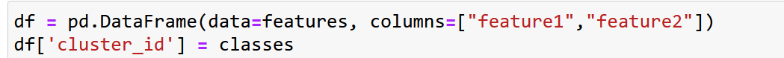
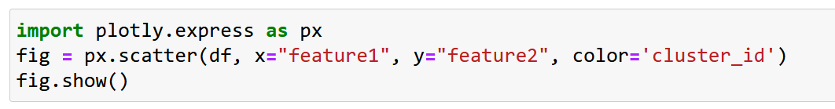
Make-blob example
Creating 100 samples with 2 features.
Plot the randomly created records above and use the generated cluster_id for color coding

Slide 16
1.4 Use Python modules to manipulate imported data and save them on disk

Slide 17
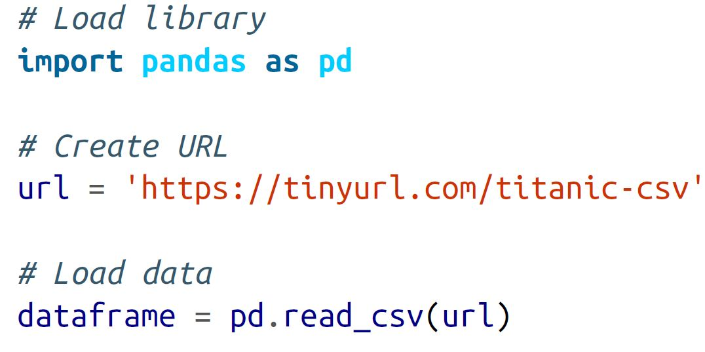

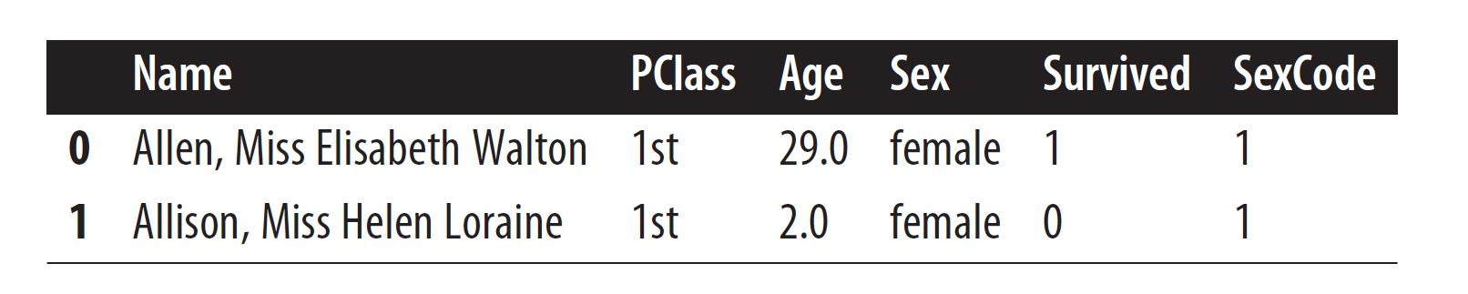
Manipulating Data
We use the Titanic dataset on Kaggle.
Use this link if the above does not work :
https://raw.githubusercontent.com/chrisalbon/simulated_datasets/master/titanic.csv
Using head() or tail() to check the first or last 5 (default) rows of the data frame

Slide 18
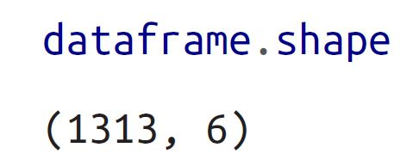
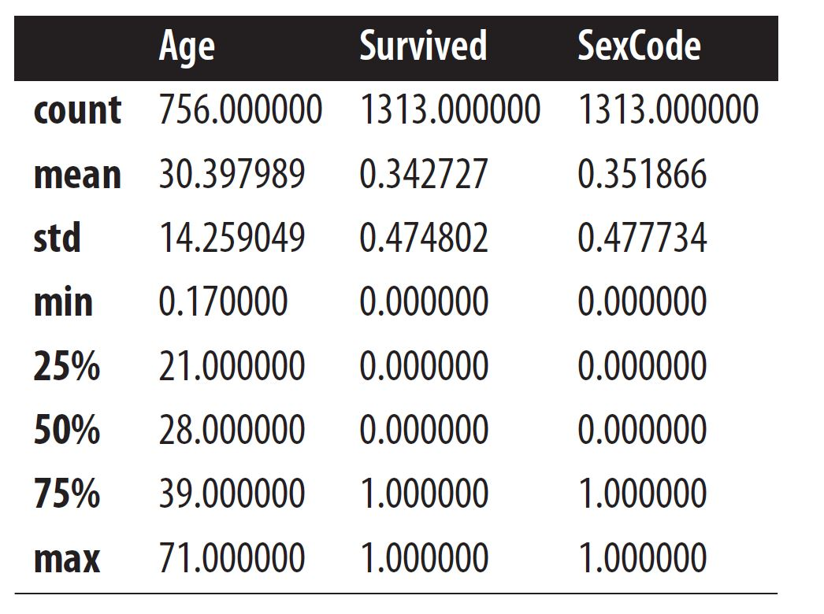
Manipulating Data
Using .shape to check the dimensions of the dataframe.
Using describe() to get descriptive statistics for any numeric columns.

Slide 19
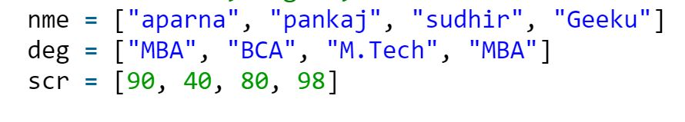
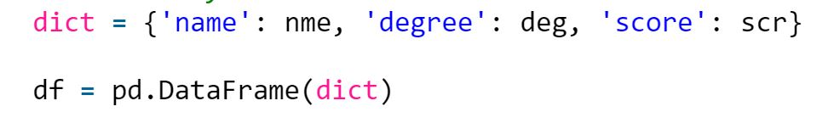
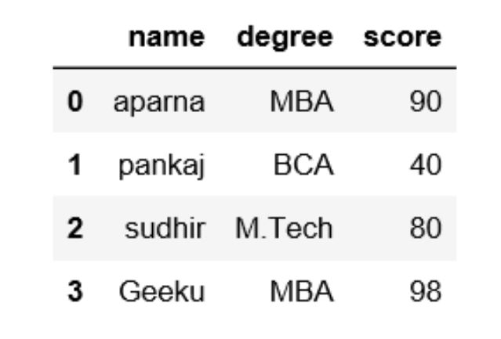

Saving dataframe
We can save dataframe using to_csv() and to to_json() functions on pandas.
Desired File name must be given (file path is optional)

Slide 20
Any questions so far? Any comments?

